Slide 1
laptop assignments
1 Melanie Alvarez
2 Mariam A. Abosheta
3 Christopher Baez
4 Michael A. Becerra
5 Emiljano Bodaj
6 Nichole Calle
7 Diego G. Del Real
8 Brent A. Figuera
9 Leslye E. Galindo
10 Oasis M. Hawk
11 Frank B. Johnson
12 Edgar Martinez Romero
13 Avery L. Mcdonald
14 Julian Montalvo
15 Eliut J. Ortiz
16 Joshua C. Pena
17 Eliezer I. Polanco
18 Kalani Quinones
19 Eric D. Razor Jr
21 Luis Reyes
22 Lucas K. Schlenk
23 Benjamin Schmitt
24 Amal Tashmatov
25 Jean P. Tatis Bueno
26 Ruben D. Tineo

Slide 2
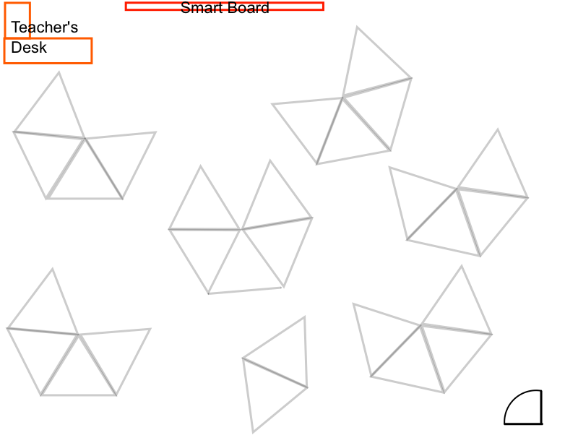
Jenisah
Donte
Nickel
Omar
Louie
Collin
Richard
Calvin
Max
Warren
Joel
Anastacio
Andrew
Grace
Ivan
Sabrina
Randy
Krista
Shahan
Nicholas
Kaylee
Esi
Michael
Porfirio
LaNature

Slide 3
F&DA Procedure
What do we need to know about how we will run this class?

Slide 4
What is research?
What is a phD?
Can we learn math from computer programming?

Slide 5
laptop assignments
1 Andrew Chan
2 Collin Chiu
3 Warren A. Coakley
4 Maxwell Ferrara
5 LaNature N. Ferreiro
6 Graciela Garcia
7 Joel L. Gonzalez
8 Donte R. Guzman
9 Nickel L. John
10 Louie Larios
11 Calvin Lee
12 Randy N. Lopez
13 Krista K. Mayes
14 Esi Mcallen
15 Richard A. Mercado
16 Porfirio K. Mohabir
17 Anastacio Morales
18 Michael R. Negron
19 Shahan Rahman
20 Jenisah L. Rodriguez
21 Nicholas C. Rodriguez
22 Omar Shah
23 Sabrina I. Uzochukwu
24 Kaylee M. Vega
25 Ivan Vera

Slide 6
instructions
go to your @afsenyc.org email and open the most recent email from Mr. Allatta, "Procedures Agenda"

